Slide 1

SPRING BOOT
By –
Priyanka Gadwe
Hardik Gupta

Slide 2
Content
Dependency Injection
Spring Boot
JPA
REST API
Postman
DNS

Slide 3
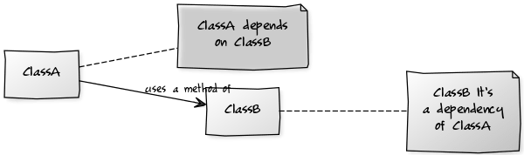
Dependency Injection in Java
Dependency injection enables you to turn regular Java classes into managed objects and to inject them into any other managed object.
Using dependency injection, your code can declare dependencies on any managed object (also called managed beans.)
The container automatically provides instances of these dependencies at the injection points at runtime, and it also manages the lifecycle of these instances for you.

Slide 4
Constructor based Injection -When container call the constructor of the class. It should be used for mandatory dependencies.
Let’s say Class X is tightly dependent on Class Y then we should use constructor based injection.
Setter based Injection - It can be used by calling setter methods on your beans. It should be used for optional dependencies.

Slide 5
Spring Boot
Spring Boot is a project that is built on the top of the Spring Framework.
It provides an easier and faster way to set up, configure, and run both simple and web-based applications.
provides the RAD (Rapid Application Development) feature to the Spring Framework.
It is used to create a stand-alone Spring-based application that you can just run because it needs minimal Spring configuration.

Slide 6
Why Spring Boot?
Spring Boot mitigates spring’s effort with three important capabilities.
Autoconfiguration-
Opinionated approach
Standalone applications

Slide 7
Autoconfiguration-
- As Java Spring Boot comes with built-in autoconfiguration capabilities, it automatically configures both the underlying Spring Framework and third-party packages based on your settings and based on best practices, which helps avoid errors.
Opinionated approach
- Spring Boot uses an this approach to adding and configuring starter dependencies, based on the needs of your project. Following its own judgment, Spring Boot chooses which packages to install and which default values to use, rather than requiring you to make all those decisions yourself and set up everything manually.
Standalone applications
- Spring Boot helps developers create applications that just run. Specifically, it lets you create standalone applications that run on their own, without relying on an external web server, by embedding a web server such as Tomcat or Netty into your app during the initialization process

Slide 8
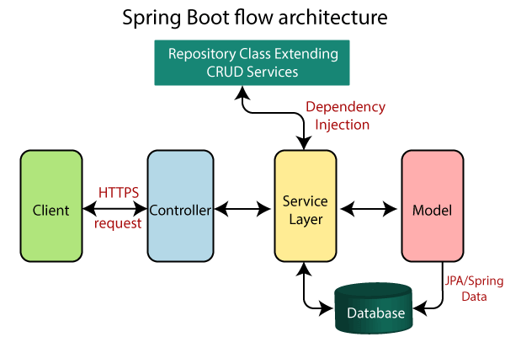

Slide 9
Execution flow
The Client makes an HTTP request(GET, PUT, POST, etc.)
The HTTP request is forwarded to the Controller. The controller maps the request. It processes the handles and calls the server logic.
The business logic is performed in the Service layer. The spring boot performs all the logic over the data of the database which is mapped to the spring boot model class through JPA
The JSP page is returned as Response from the controller.

Slide 10
JPA
JPA stands for Java Persistence API,
JPA is a ORM tool - ORM (Object Relation Mapping ).
- ORM is simply the process of persisting any java object directly into a database table.
-Usually, the name of the object being persisted becomes the name of the table, and each field within that object becomes a column.
JPA is just guidelines to implement ORM and there is no underlying code for the implementation.

Slide 11
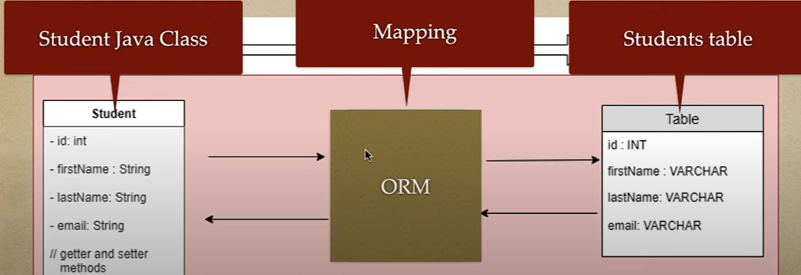

Slide 12
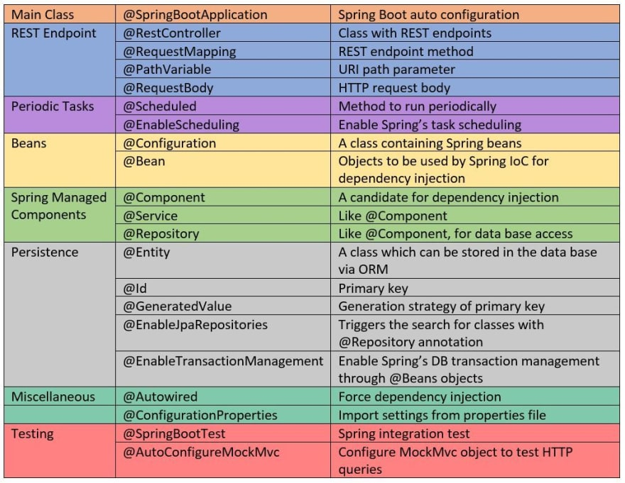
Useful Annotations

Slide 13
REST API Basics & Tools

Slide 14
Traditional web applications
GET /the-resource ...
Client
Server
200 OK
<html>Code...</html>
Displays the page, then user clicks on link.
GET /another-resource ...
Displays the other page, ...
200 OK
<html>Code...</html>

Slide 15
Traditional web applications
The interface is built on HTML & HTTP.
Drawbacks:
The client must understand both HTTP and HTML.
The entire webpage is replaced with another one.
No way to animate transitions between webpages.
Same data is usually sent in multiple responses.
E.g. HTML code for the layout.

Slide 16

Traditional web applications
HTTP & HTML
???
Client
Client
Server
HTTP & HTML can be used, but is not optimal.
The GUI on smartphones does not use HTML.
E.g. GET /users/3:
Age
City
Name
<h1>Claire</h1>
<p>Claire is 24 years old and lives in Boston.</p>

Slide 17


Application programming interface
A GUI is an interface for Human ↔ Machine communication.
API
GUI
Client
User
Server
An API is an interface for Machine ↔ Machine communication.
An API making use of HTTP is called a Web API.

Slide 18
What does REST mean?
Id | Name
1 | Alice
2 | Bob
3 | Claire
Client
GET /users/2 ...
Server
Users
{"id": 2, "name": "Bob"}
Changes state.
{"id": 2, "name": "Obi"}
PUT /users/2 {"id": 2, "name": "Obi"}

Slide 19
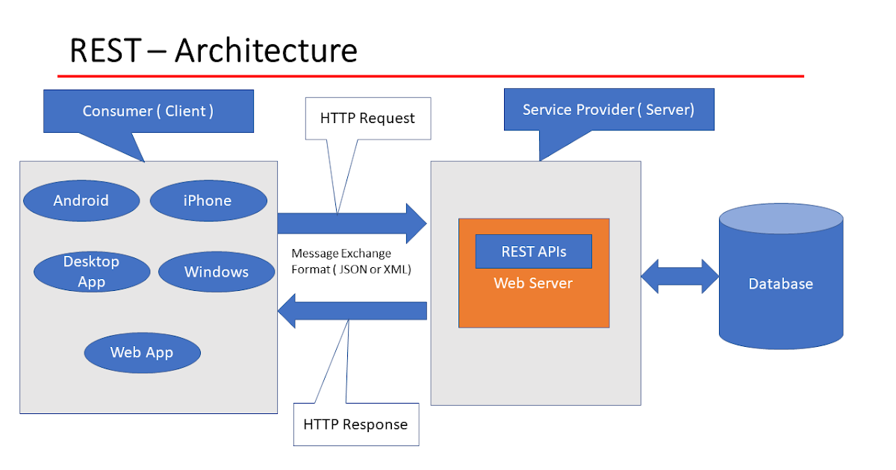

Slide 20
Using HTTP as the uniform interface
Use URIs to identify resources.
Use HTTP methods to specify operation:
Create: POST (or PUT)
Retrieve: GET
Update: PUT (or PATCH)
Delete: DELETE
Use HTTP headers Content-Type and Accept to specify data format for the resources.
Use HTTP status code to indicate success/failure.
Bad
POST /login
POST /create-book
GET /get-top-10-books
Good
POST /login-sessions
POST /books
GET /top-10-books

Slide 21
REST example
Id | Name
1 | Alice
2 | Bob
3 | Claire
A server with information about users.
The GET method is used to retrieve resources.
GET /users
GET /users/2
GET /users/pages/1
GET /users/gender/female
GET /users/age/18
GET /users/???
GET /users/2/name
GET /users/2/pets
Users
GET /users?page=1
GET /users?gender=female
GET /users?age=18
GET /users?gender=female&age=18

Slide 22
REST example
Id | Name
1 | Alice
2 | Bob
3 | Claire
A server with information about users.
The GET method is used to retrieve resources.
Which data format? Specified by the Accept header!
Users
GET /users HTTP/1.1
Host: the-website.com
Accept: application/json
HTTP/1.1 200 OK
Content-Type: application/json
Content-Length: 66
[
{"id": 1, "name": "Alice"},
{"id": 2, "name": "Bob"}
]
application/xml was popular before JSON.

Slide 23
REST example
Id | Name
1 | Alice
2 | Bob
3 | Claire
A server with information about users.
The POST method is used to create resources.
Which data format? Specified by the Accept and Content-Type header!
Users
POST /users HTTP/1.1
Host: the-website.com
Accept: application/json
Content-Type: application/xml
Content-Length: 49
<user>
<name>Claire</name>
</user>
HTTP/1.1 201 Created
Location: /users/3
Content-Type: application/json
Content-Length: 28
{"id": 3, "name": "Claire"}

Slide 24
REST example
Id | Name
1 | Alice
2 | Bob
3 | Claire
A server with information about users.
The PUT method is used to update an entire resource.
Users
PUT /users/3 HTTP/1.1
Host: the-website.com
Content-Type: application/xml
Content-Length: 52
<user>
<id>3</id>
<name>Cecilia</name>
</user>
HTTP/1.1 204 No Content
PUT can also be used to create a resource if you know which URI it should have in advance.

Slide 25
REST example
Id | Name
1 | Alice
2 | Bob
3 | Claire
A server with information about users.
The DELETE method is used to delete a resource.
Users
DELETE /users/2 HTTP/1.1
Host: the-website.com
HTTP/1.1 204 No Content

Slide 26
REST example
Id | Name
1 | Alice
2 | Bob
3 | Claire
A server with information about users.
The PATCH method is used to update parts of a resource.
Users
PATCH /users/1 HTTP/1.1
Host: the-website.com
Content-Type: application/xml
Content-Length: 37
<user>
<name>Amanda</human>
</user>
HTTP/1.1 204 No Content
The PATCH method is only a proposed standard.

Slide 27
REST example
Id | Name
1 | Alice
2 | Bob
3 | Claire
A server with information about users.
What if something goes wrong?
Use the HTTP status codes to indicate success/failure.
Users
GET /users/999 HTTP/1.1
Host: the-website.com
Accept: application/json
HTTP/1.1 404 Not Found
Read more about the different status codes at:
http://www.restapitutorial.com/httpstatuscodes.html
Optionally include error messages in the response body.

Slide 28
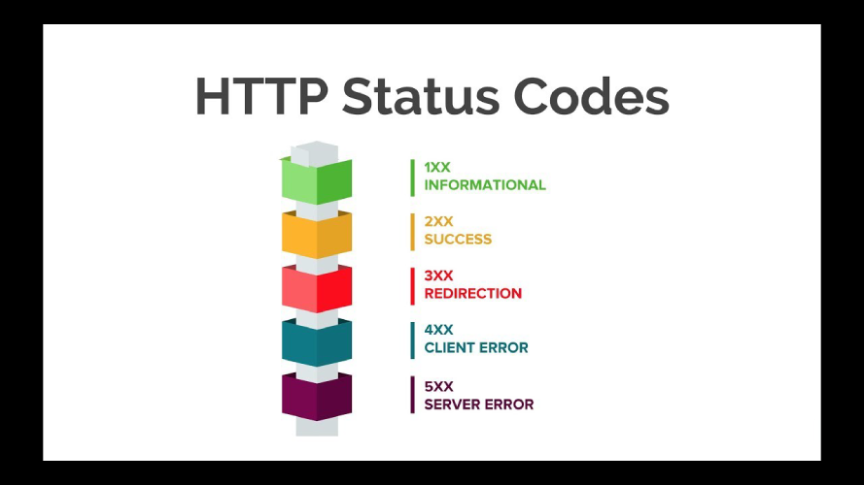
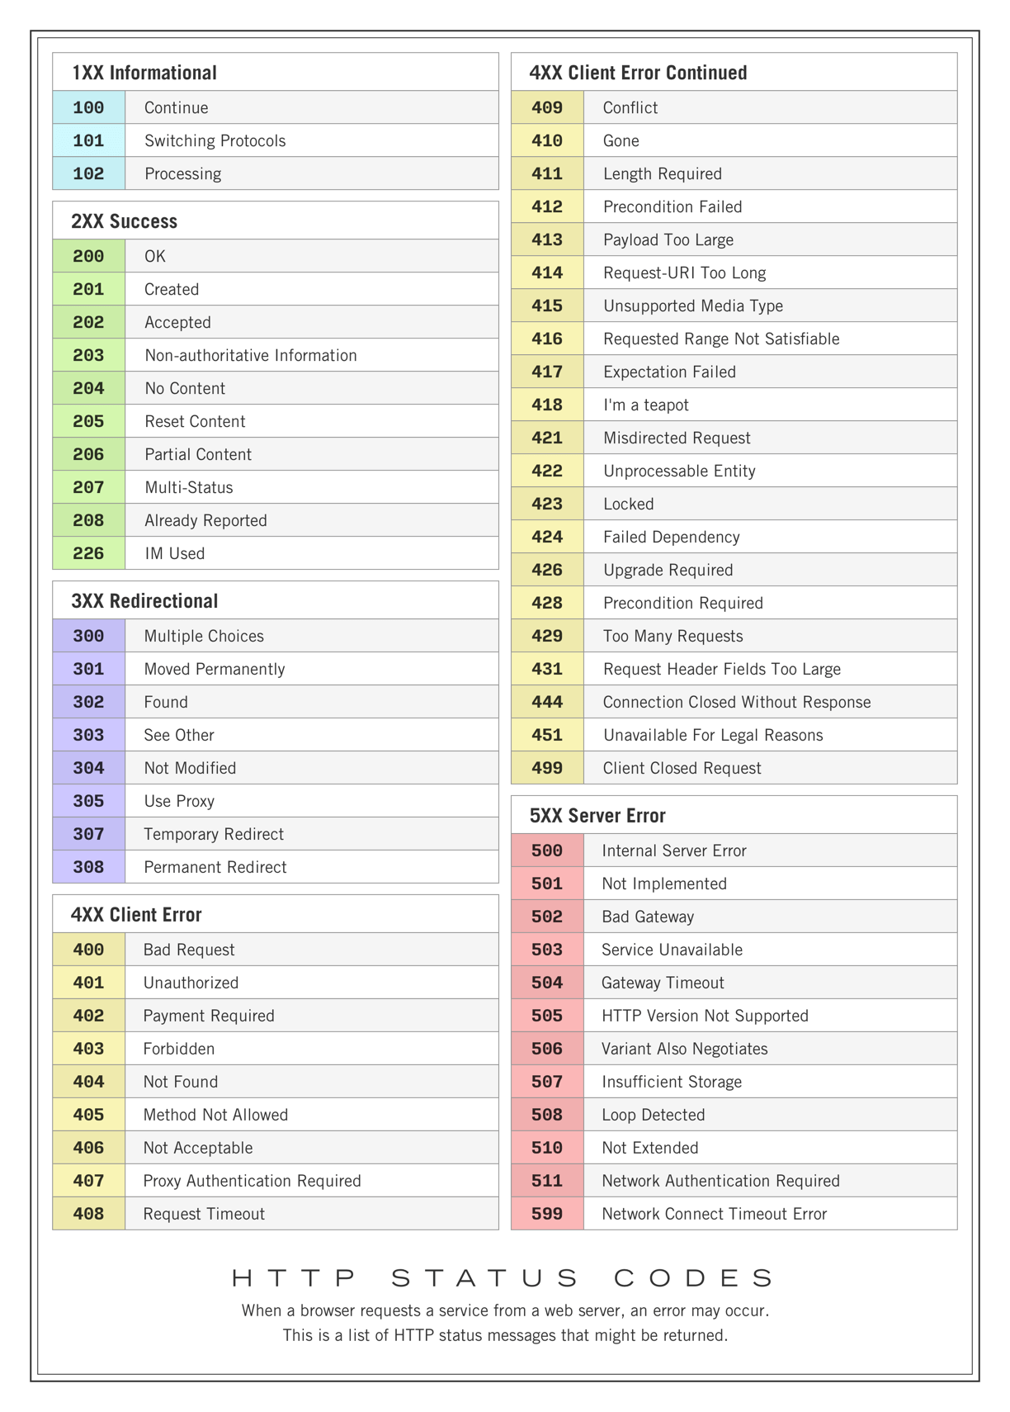

Slide 29

API Test Clients
Postman is an API Platform for developers to design, build, test and iterate their APIs. As of February 2023, Postman reports having more than 25 million registered users and 75,000 open APIs, which it says constitutes the world's largest public API hub.
License: Proprietary (with open source components)
Initial release: 2012
Operating system: Windows, macOS, Linux
Stable release: 10.12.9
Downloads –
https://insomnia.rest/
https://www.postman.com/downloads/

Slide 30
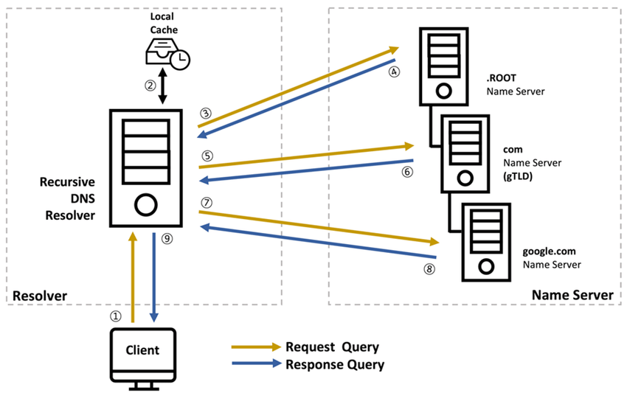
DNS – Domain Name System

Slide 31
DNS – Domain Name System
The Domain Name System (DNS) is the phonebook of the Internet. Humans access information online through domain names, like nytimes.com or espn.com. Web browsers interact through Internet Protocol (IP) addresses. DNS translates domain names to IP addresses so browsers can load Internet resources.
Each device connected to the Internet has a unique IP address which other machines use to find the device. DNS servers eliminate the need for humans to memorize IP addresses such as 192.168.1.1 (in IPv4), or more complex newer alphanumeric IP addresses such as 2400:cb00:2048:1::c629:d7a2 (in IPv6).
DNS searching works in two modes – Iterative Searching and Recursive Searching

Slide 32
Thank You !!

